Slide 1
ALGORITHMIC BIAS AND FEEDBACK: BIAS ON THE WEB
Kristina Lerman
March 27, 2024
DSCI 531

Slide 2

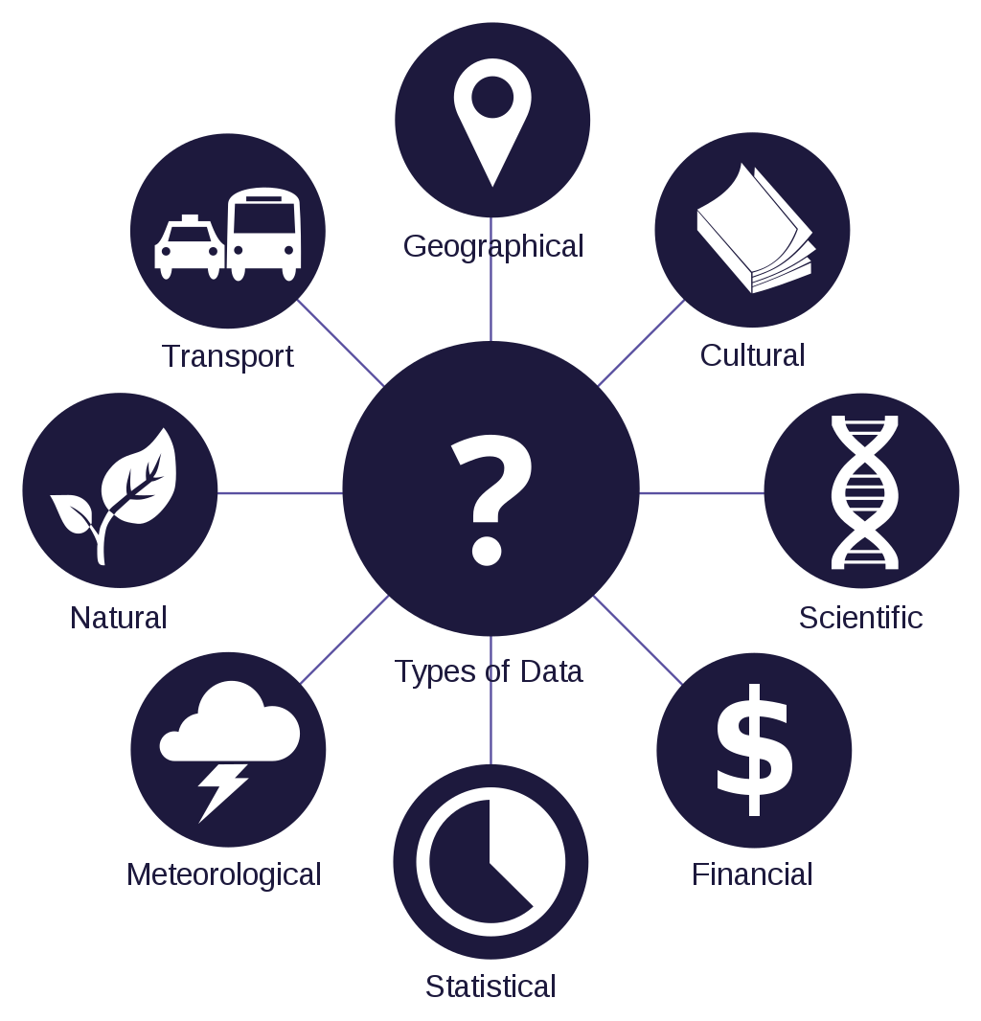

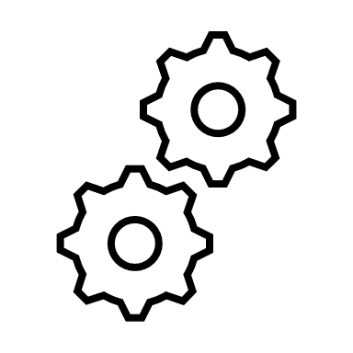

Algorithmic pipeline
ground truth data for training
recommend content
sell products
make decisions
data
algorithms
applications

Slide 3
AI pipeline
Data is biased
Gender, Race, Sex, …
Social
Linguistic
Geographic
Political
Educational
Economic
Technological
Data collection is biased
Incomplete
Non-representative
Measurability bias
…
Training data is biased
Noisy
Subjective
Biased
Algorithms are biased
Unfair
Biased process for measuring bias
Defining outcomes, objective functions, …
People are biased
Cognitive bias
Personality bias
Social bias
Cultural bias
Language bias
ground truth data for training
recommend content
sell products
make decisions
data
algorithms
applications
Feedback creates more data

Slide 4
Bias on the Web
[Baeza-Yates, R. (2018). Bias on the web. Communications of the ACM, 61(6), 54-61.]
Any remedy for bias starts with awareness of its existence.
Bias on the Web reflects biases within ourselves, manifested in subtler ways.
We must consider and account for bias in the design of Web-based systems that truly address the needs of users.

Slide 5
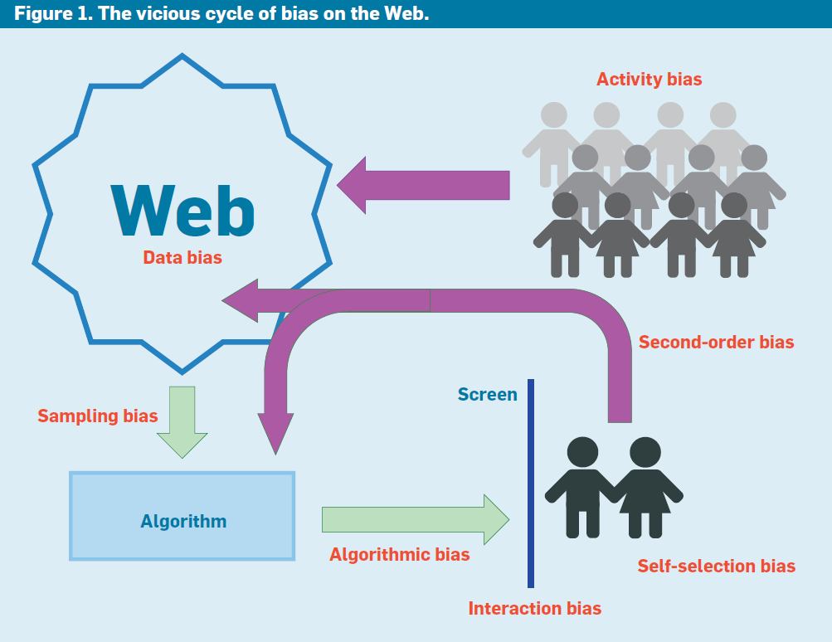
[Baeza-Yates, R. (2018). Bias on the web. Communications of the ACM, 61(6), 54-61.]
Every decision and interaction creates an opportunity for bias to creep in
Biases compound

Slide 6
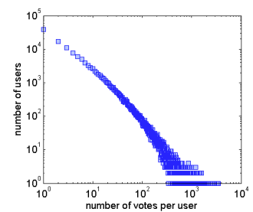
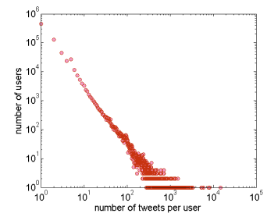
Online engagement is highly heterogeneous
Only a few users are very active – most are inactive
Typically, activity (number of likes/tweets/retweets per user) has an L-shaped form
Use log-log plot to visualize (plots on the left)
Indicative of high inequality of activity
Stories liked per user on Digg
Number of tweets per user on Twitter

Slide 7
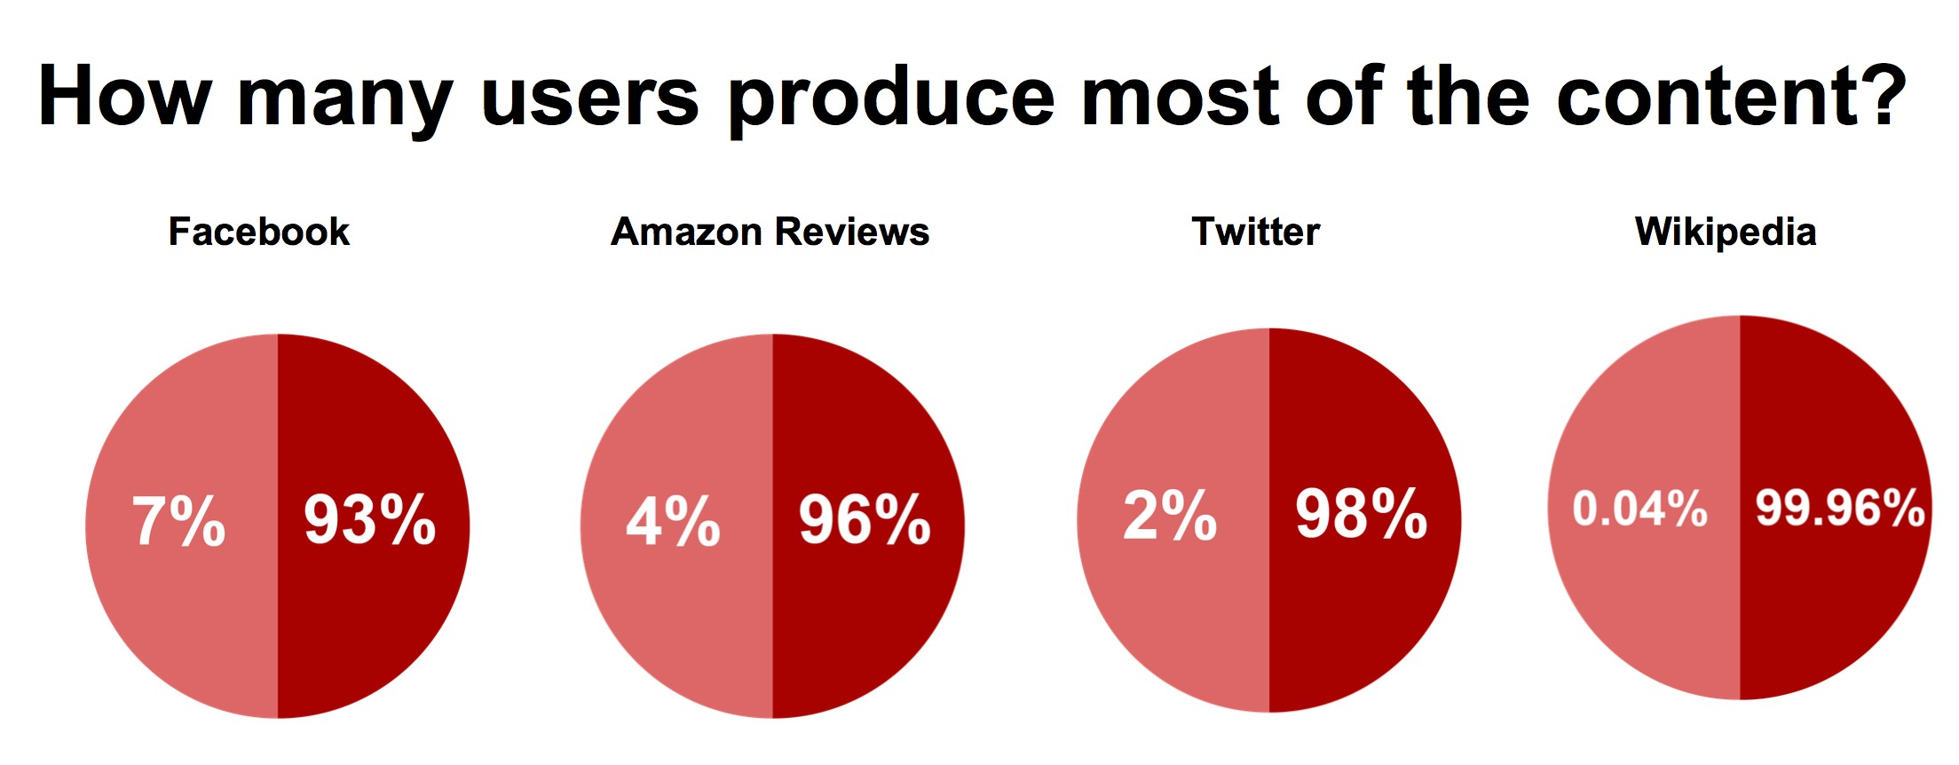
Activity Bias, or Wisdom of a Few
Link bias
half of the Twitter users in the dataset were following only a few select celebrities (0.05% of the most popular people attracted almost 50% of all participants);
Activity bias

Slide 8
“digital desert”
Activity bias generates a “digital desert” across the Web, or Web content no one ever sees.
1.1% of the tweets were written by people without followers.
31% of the Wikipedia articles added or modified in May 2014 were never visited in June.
The size of the digital desert on the Web is in the 1% to 31% range.

Slide 9
The Web works thanks to bias
Web traffic
Local caching
Proxy/Akamai caching
Search engines
Answer caching
Essential web pages
25% queries can be answered with less than 1% of the URLs [Baeze-Yates, Boldi, Chierichetti, WWW 2015]
E-commerce
Most revenue comes from few items

Slide 10
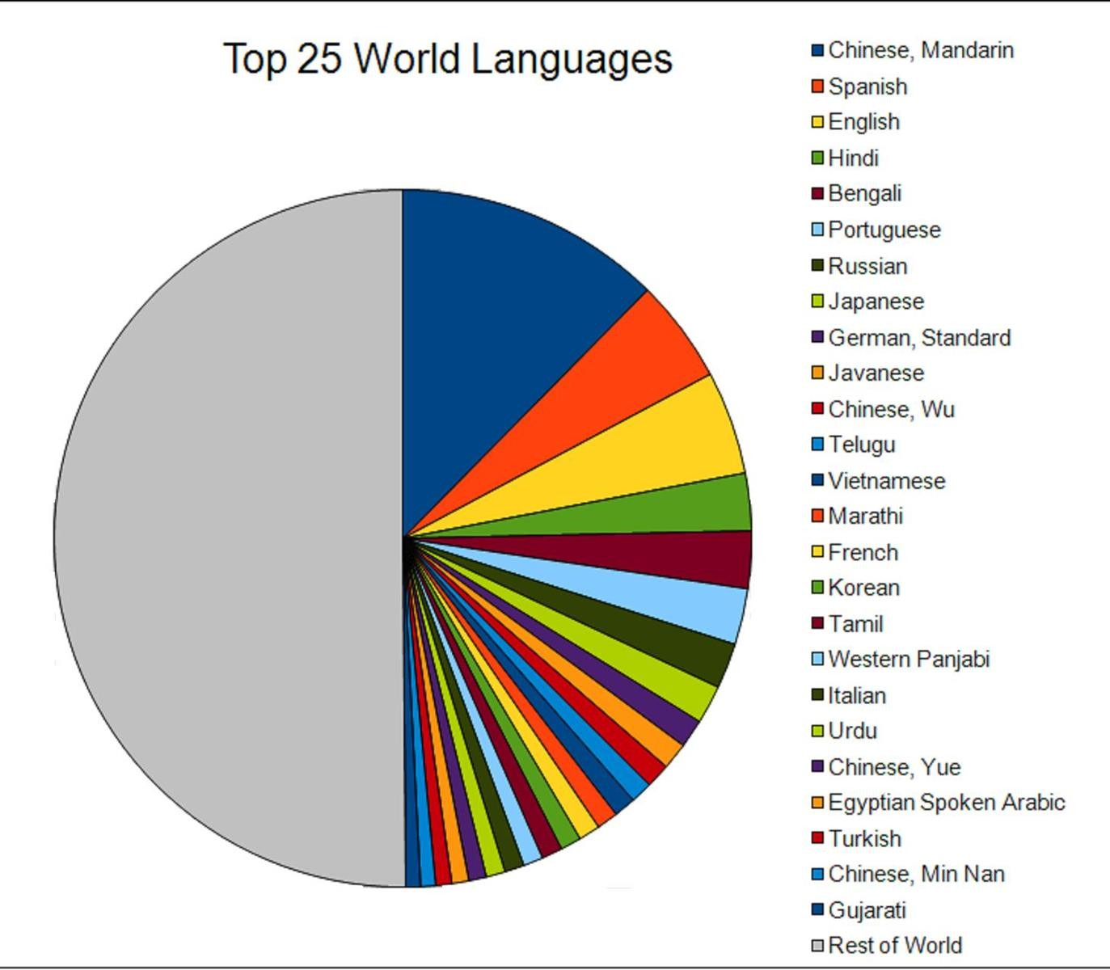
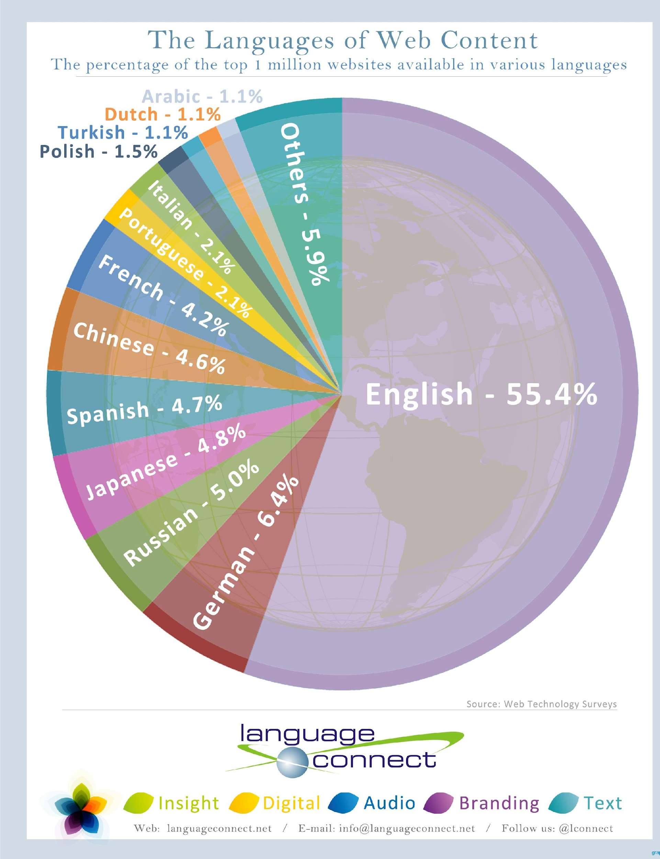
Linguistic bias

Slide 11
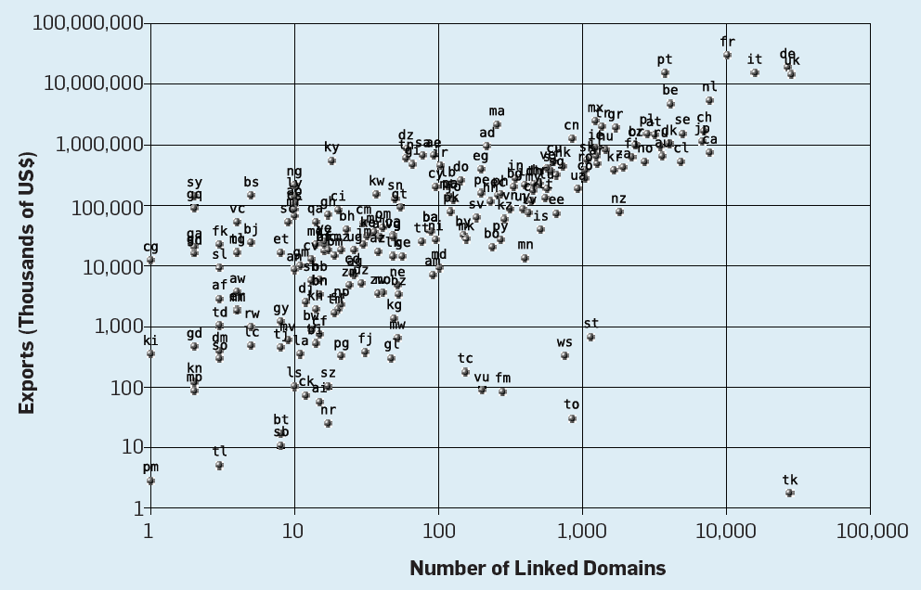
Geographic bias

Slide 12
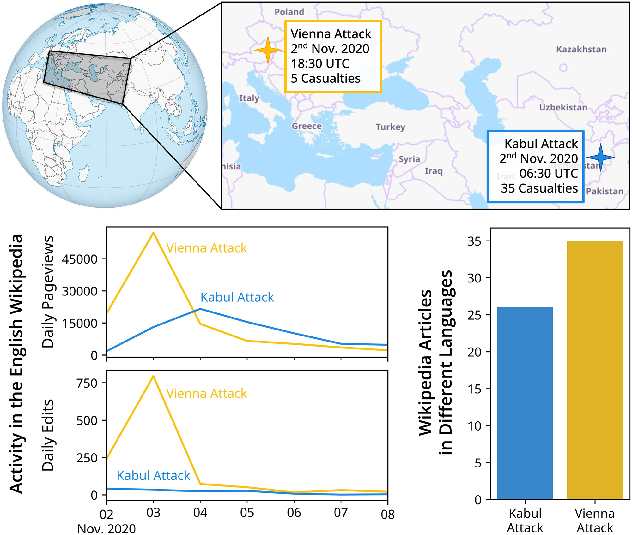
Wealth and regional disparities in attention to events on Wikipedia
Ruprechter T, Burghardt K, Helic D (2023) Poor attention: The wealth and regional gaps in event attention and coverage on Wikipedia. PLoS ONE 18(11): e0289325. https://doi.org/10.1371/journal.pone.0289325

Slide 13
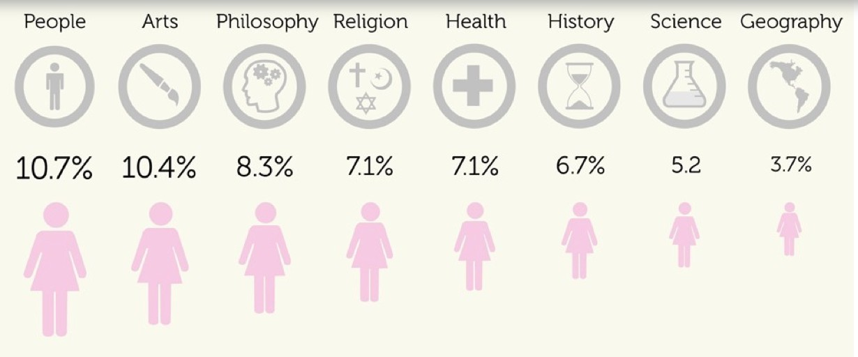
Gender bias in Wikipedia
[E. Graells-Garrido et al,. “First Women, Second Sex: Gender Bias in Wikipedia”, ACM Hypertext’15]

Slide 14
Interaction between biases in content creation
Systematic gender bias through history
But, content creation bias too
less than 12% of Wikipedia biography editors are women
Worse gender bias in other categories (e.g., 4% of geography editors are women)
70% of influential journalists in the U.S. are men,
Algorithms learning from news articles are thus learning from texts with systemic gender bias.
There could be additional cultural and cognitive biases
Feedback loops amplify bias!

Slide 15
Platforms & biases
User interactions on websites will be biased to what is shown
In search systems top ranked results will get more clicks than other results
Ranking bias
The top-ranked result will thus attract more clicks than the others because it is both the most relevant and also ranked in the first position.
To avoid ranking bias, Web search engines need to de-bias click distribution
Otherwise, the popular pages become even more popular.
Interaction bias
In recommender systems, items recommended will get more clicks than items not recommended
Vast amount of content not shown to users
…

Slide 16
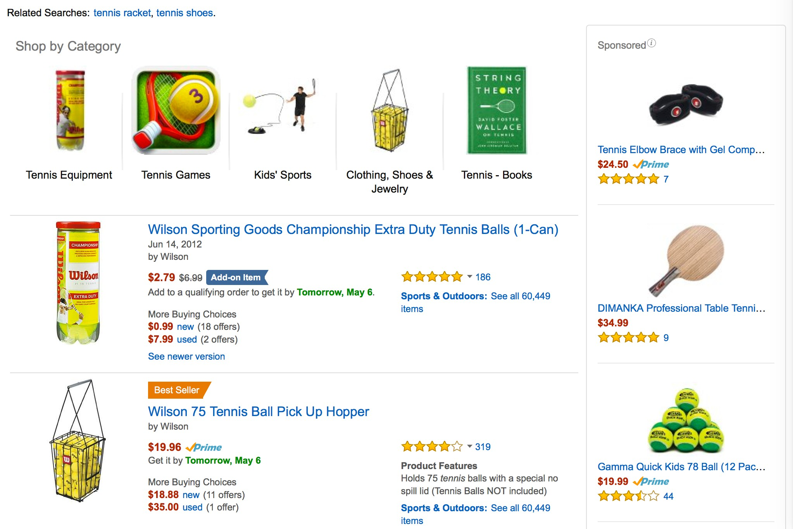
Biases in the user interface
Position bias
Ranking bias
Presentation bias
Social bias
Interaction bias

Slide 17
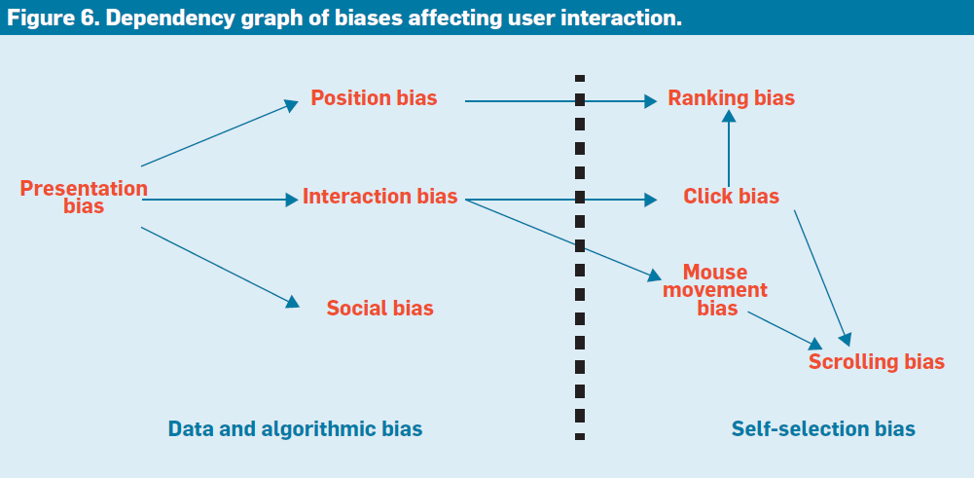
Cascading biases

Slide 18
Cascading bias: Bias begets bias
Personalization algorithms (aka the filter-bubble effect),
If a personalization algorithm uses only our interaction data, we see only what we want to see, thus biasing the content to our own selection biases,
Confirmation bias
We pay engage with content that is congruent with our pre-existing beliefs, feeding more biased information to personalization algorithms
Create feedback loops that amplify bias, a common mechanism across domains

Slide 19
A very common mechanism for amplifying bias
Negative feedback loops: Disadvantage begets more disadvantage
Positive feedback loops: Advantage begets more advantage
Cumulative advantage in science [Merton 1968]: Patterns of recognition are skewed in favor of the privileged
aka “the rich get richer and the poor get poorer”
“eminent scientists get disproportionately great credit for their contributions to science while relatively unknown scientists tend to get disproportionately little credit for comparable contributions.”
Also see preferential attachment in networks: a few nodes get most of the links [Barabasi & Albert 1999]
poverty
poor health
stress

Slide 20
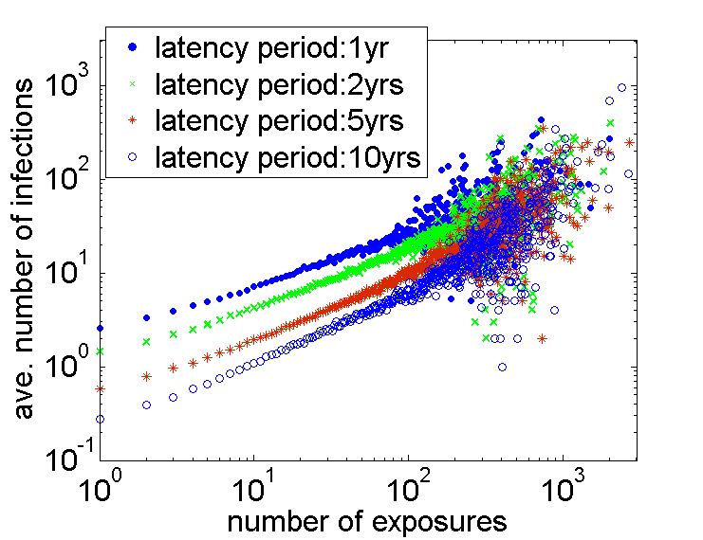
Cumulative advantage in science: citations
Citations beget citations: each citation of a paper exposes to a wider audience, creating opportunities for others to find and cite it in their work.
Average new citations
My paper
APS paper citations
Direct citations
Exposures
Exposures
Source: https://arxiv.org/abs/1710.00269

Slide 21
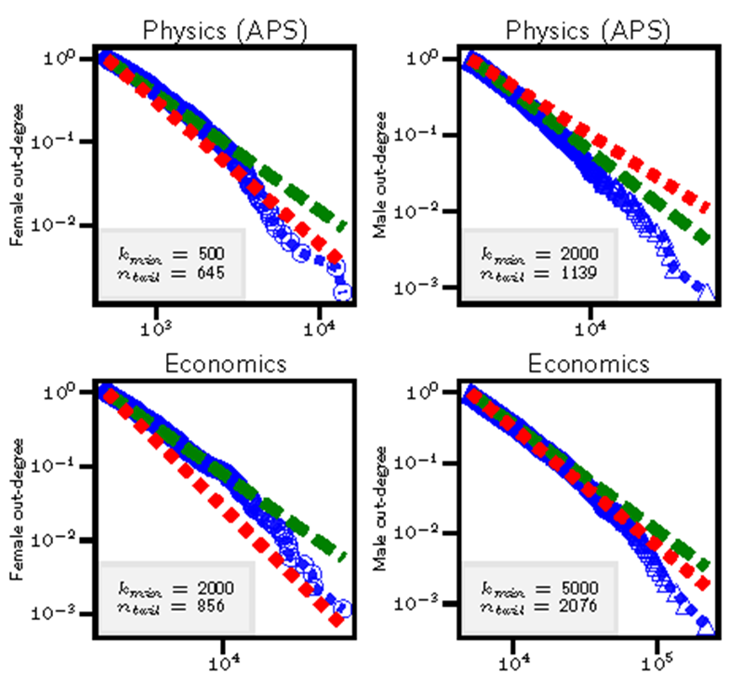
Inequality of recognition: citations
The number of citations is highly skewed
Most researchers have only a few citations
A small number of researchers have large number of citations
Gini ~ 0.6-0.7
Similar distribution for the number of followers on Twitter, the number of “likes” tweets receive, etc.
Number of citations

Slide 22
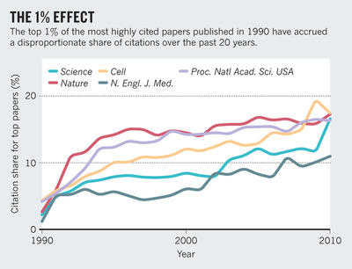
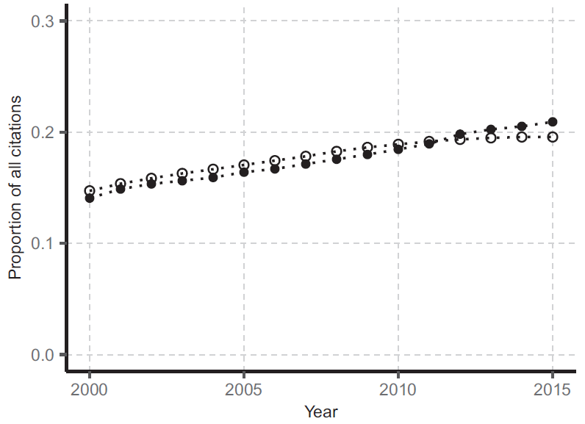
Inequality in science
A handful of papers dominates citations
A handful of authors dominate citations: Share of citations going to the top-1% most-cited authors
Barabási, A. L., Song, C., & Wang, D. (2012). Handful of papers dominates citation. Nature, 491(7422), 40-40.
Nielsen, M. W., & Andersen, J. P. (2021). Global citation inequality is on the rise. Proceedings of the National Academy of Sciences, 118(7).

Slide 23
COGNITIVE BIASES

Slide 24
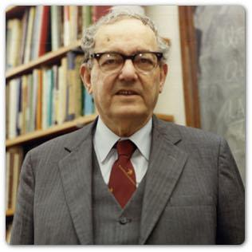

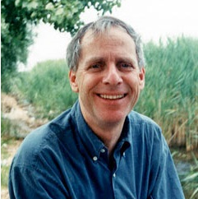
Bounded rationality (aka “thinking is hard”)
Herbert A. Simon
Daniel Kahneman
Amos Tversky
Bounded rationality
Constraints of available time, information, and cognitive capacity limit human ability to make rational decisions
Heuristics and biases
Mental shortcuts that help people make quick, but less accurate decisions, by focusing brain’s limited resources on the most salient information
[Simon (1957). "A Behavioral Model of Rational Choice", in Mathematical Essays on Rational Human Behavior in a Social Setting.]
[Tversy and Kahneman (1974). Judgment under uncertainty: Heuristics and biases. Science
Kahneman (2011) Thinking Fast and Slow. ]
Notes:
Faster but less accuirate

Slide 25
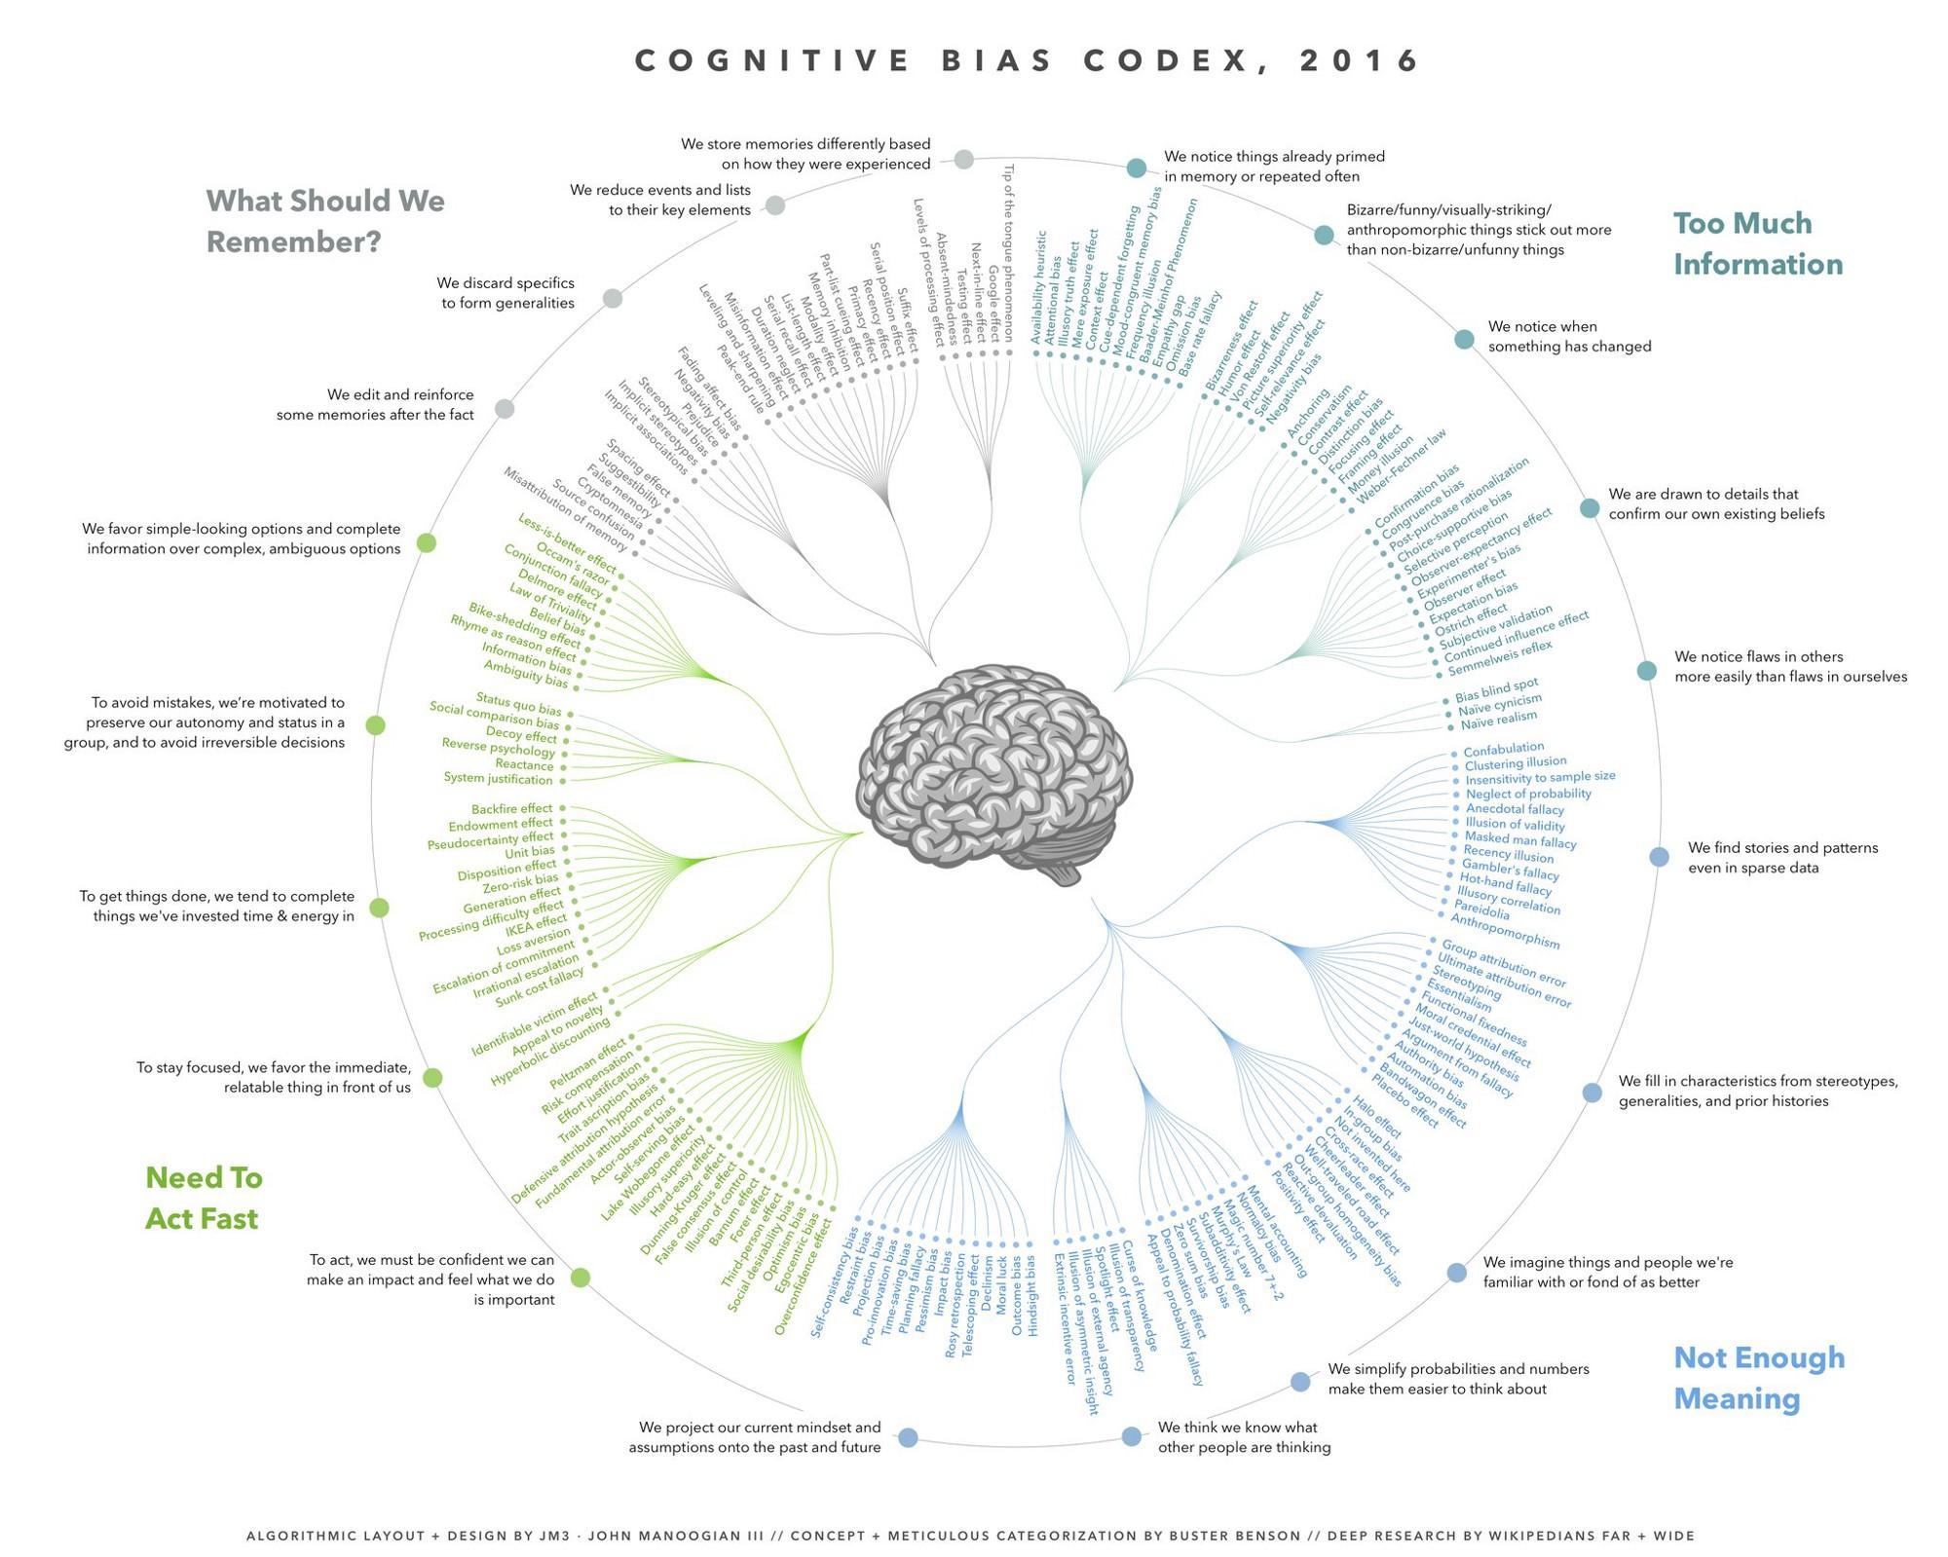

Slide 26
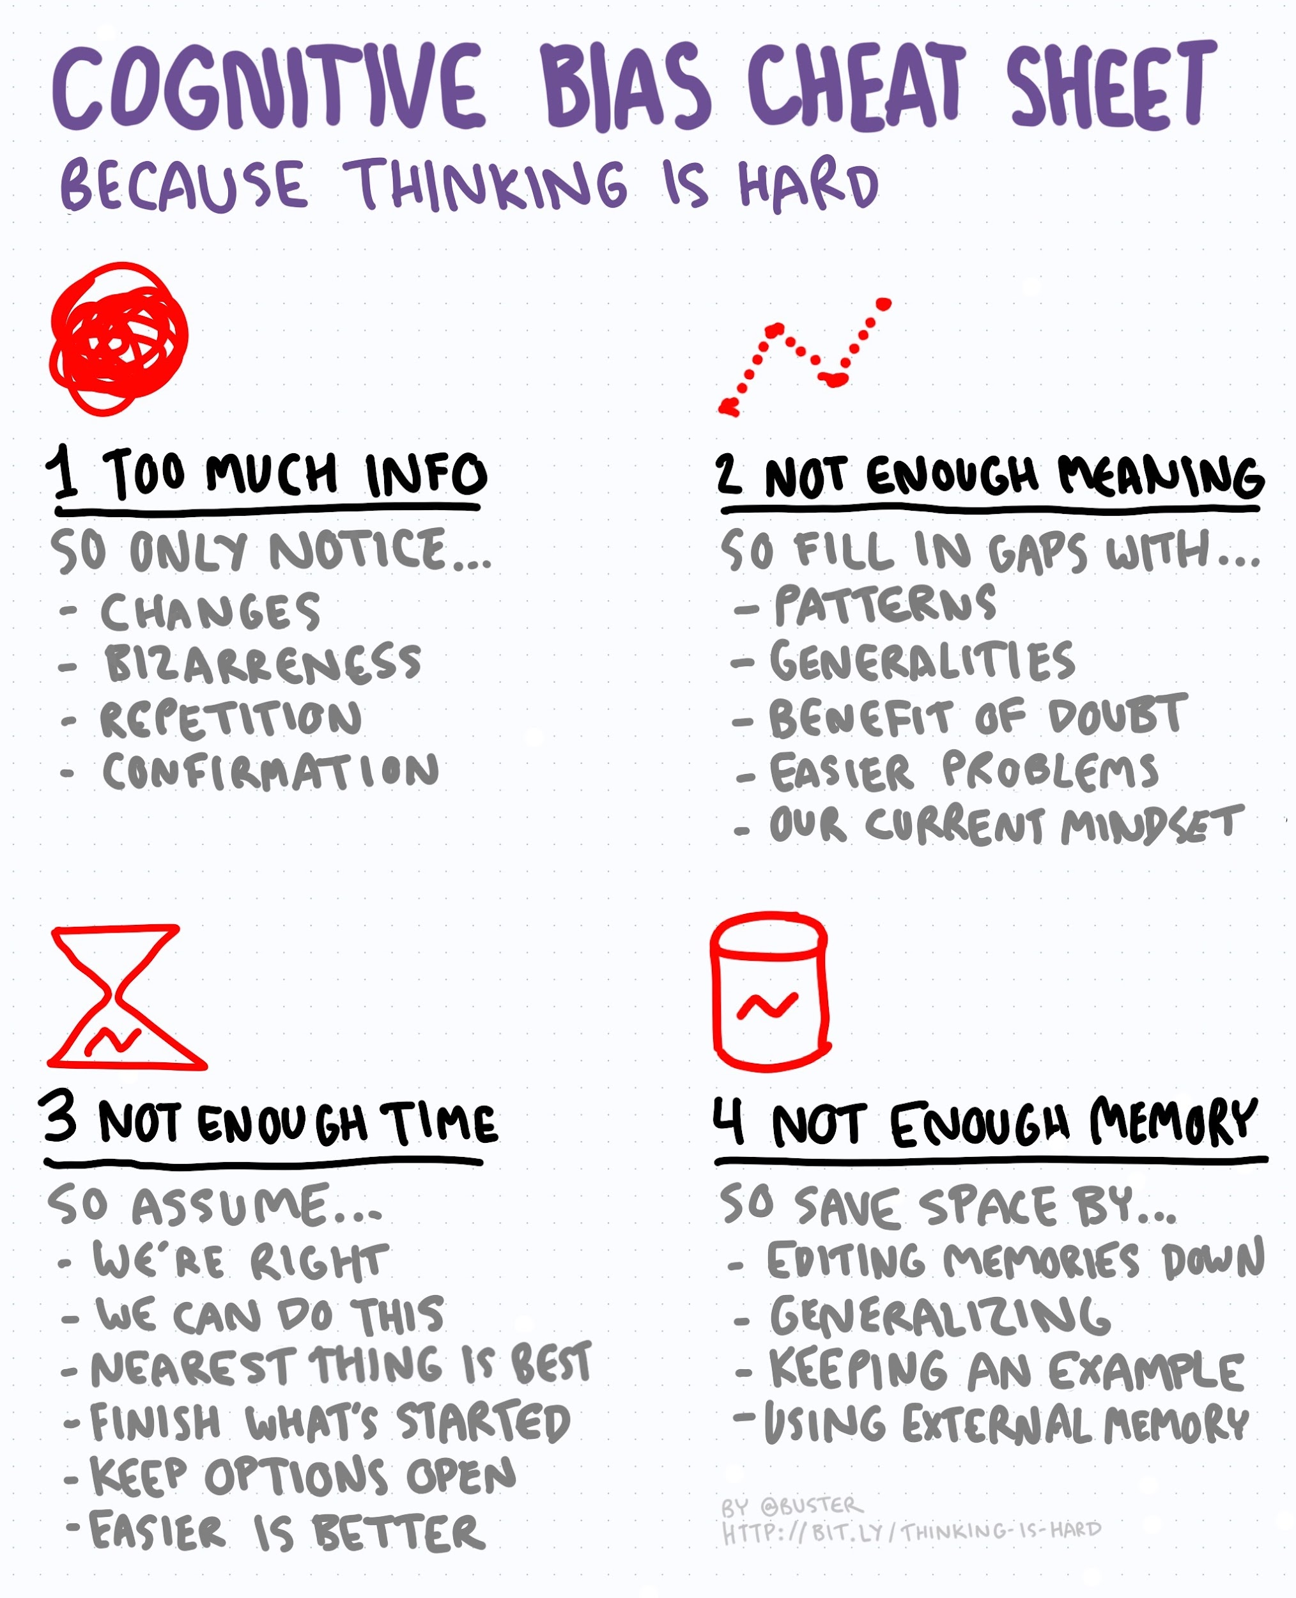
How do individual biases affect online behavior

Slide 27
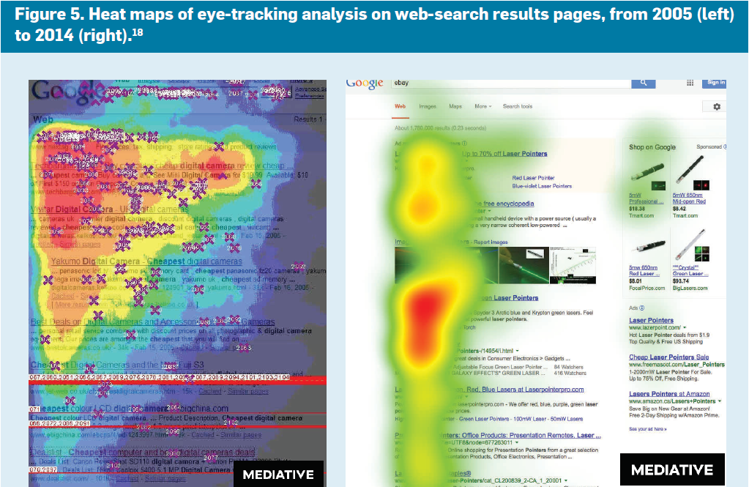
Content near the top or near images attracts attention
Position bias: People pay more attention to items at the top of the screen or a list of items [Payne 1951]

Slide 28
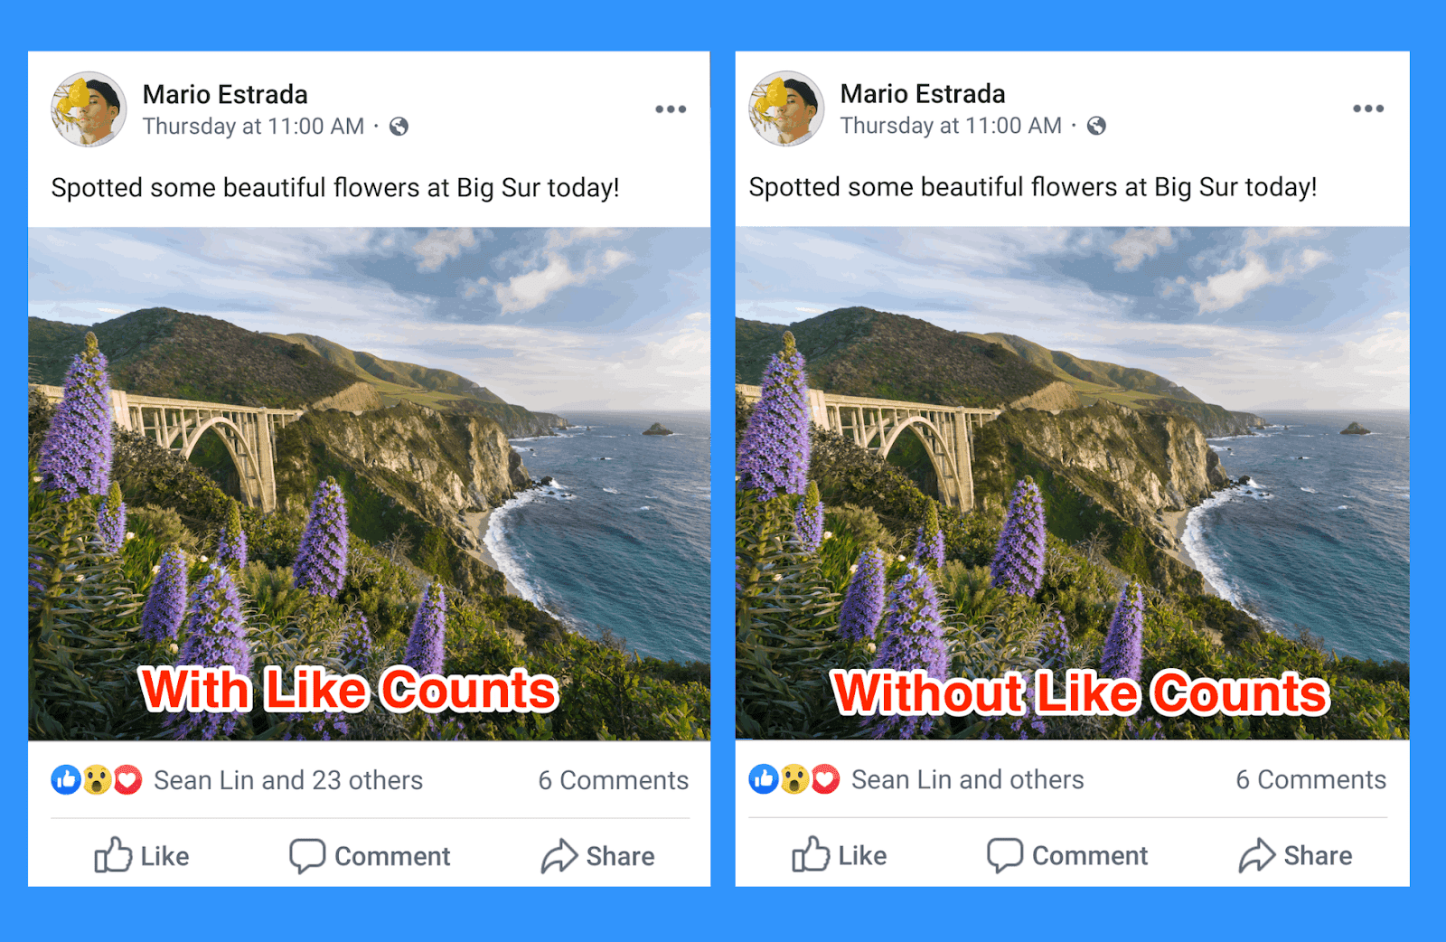
Social proof bias
Signals from other people affect our judgment.
“social conformity,” “the herding effect”, or “the bandwagon effect”

Slide 29
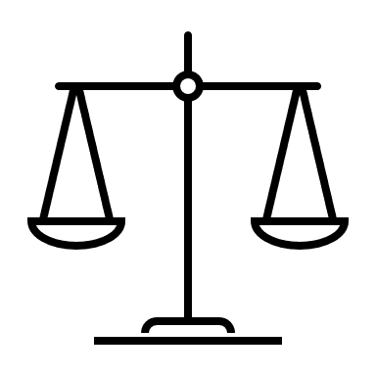
Negativity bias: Bad is stronger than good*
Asymmetry in human perception
Criticism affects us more than praise; Negative first impressions are harder to overcome
Negative emotions have stronger impact than positive emotions
News coverage is mostly negative
Negatively-biased credulity
Negative information (e.g., about threats) is more likely to be believed
Associated with ideology; conservatives more likely to believe negative information
good
bad
* Baumeister, R. F., Bratslavsky, E., Finkenauer, C., & Vohs, K. D. (2001). Bad is stronger than good. Review of general psychology, 5(4), 323-370.

Slide 30
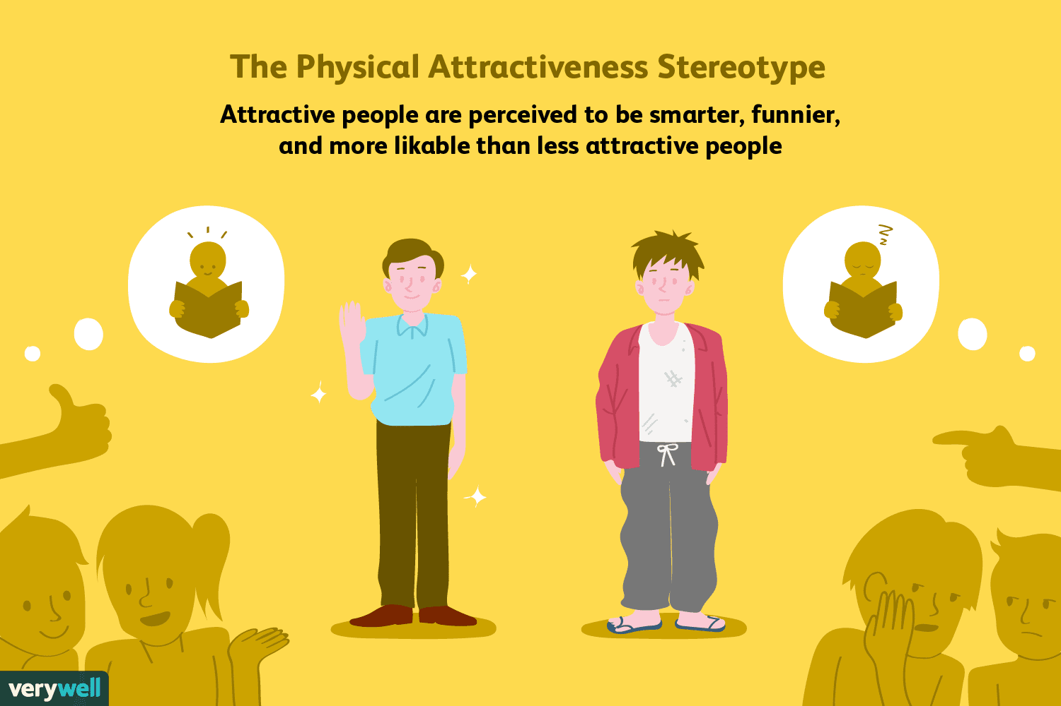
Halo effect
Tendency for positive impressions of a person in one area to positively or negatively influence one's opinion or feelings in other areas.
One trait of a person or a thing is used to make an overall judgment about them

Slide 31
INTERACTIONS BETWEEN COGNITIVE BIASES & ALGORITHMS

Slide 32
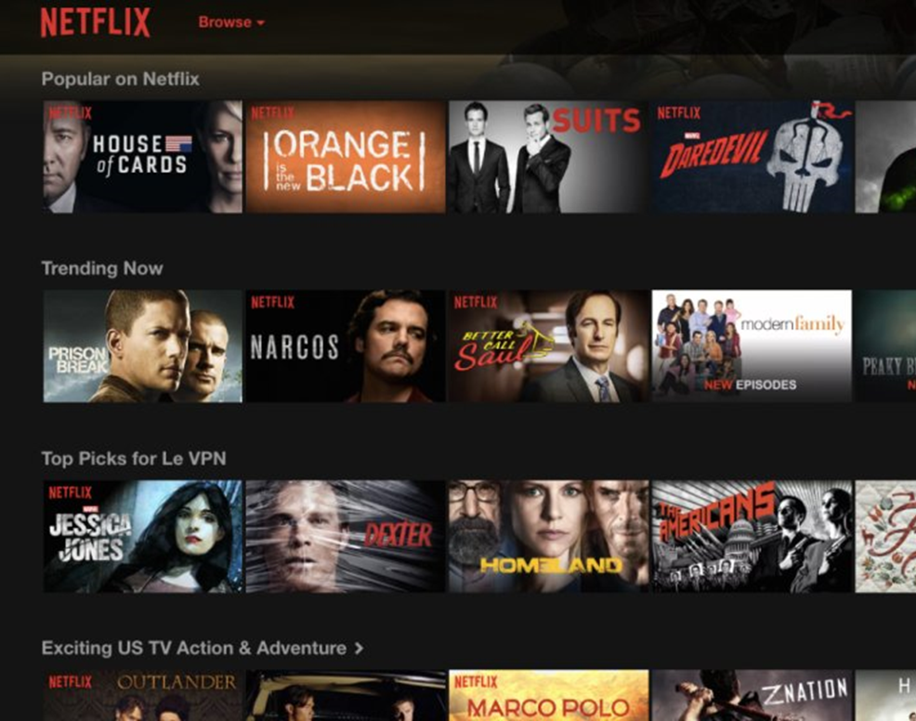
Crowdsourced ranking
Popularity ranking: Popular on Netflix (or Twitter, Reddit, StackOverflow, …)
Crowdsourced ranking
aggregates decisions of many people to rank items
“quality items float to the top”
Instability in popularity ranking
Music Lab study [Salganik+ 2006]
Few items become hits; most languish in obscurity
Can’t predict what items become hits
Harry Potter book was rejected 9 times

Slide 33
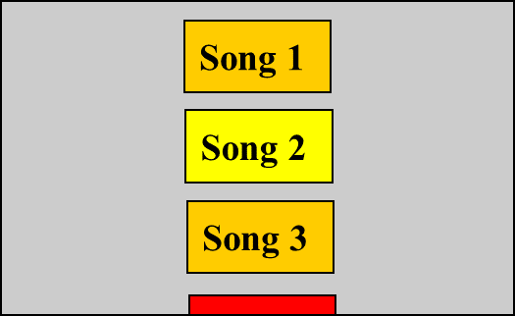
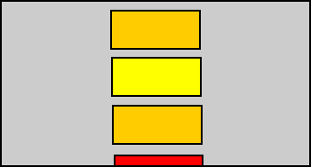
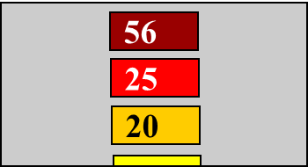
MusicLab study
Matthew J. Salganik, Peter Sheridan Dodds, Duncan J. Watts. Experimental Study of Inequality and Unpredictability in an Artificial Cultural Market. Science 10 Feb 2006 : 854-856
Online experiment to simulate a cultural market
Users shown a list of songs in one of two conditions
Independent: songs in random order
Social influence: songs ranked by popularity
Users download songs they like
Popularity = fraction of all downloads a song receives
Quality = popularity in the independent condition
Independent
Social influence

Slide 34
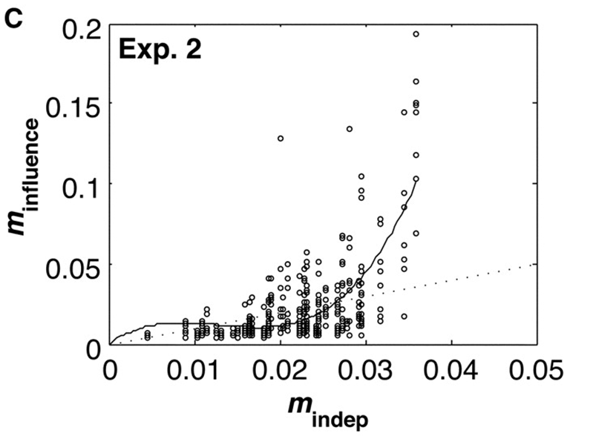
Popularity vs quality
Song market share*: social influence vs independent conditions
= quality
* market share = fraction of all downloads in an experiment attributed to a given song

Slide 35
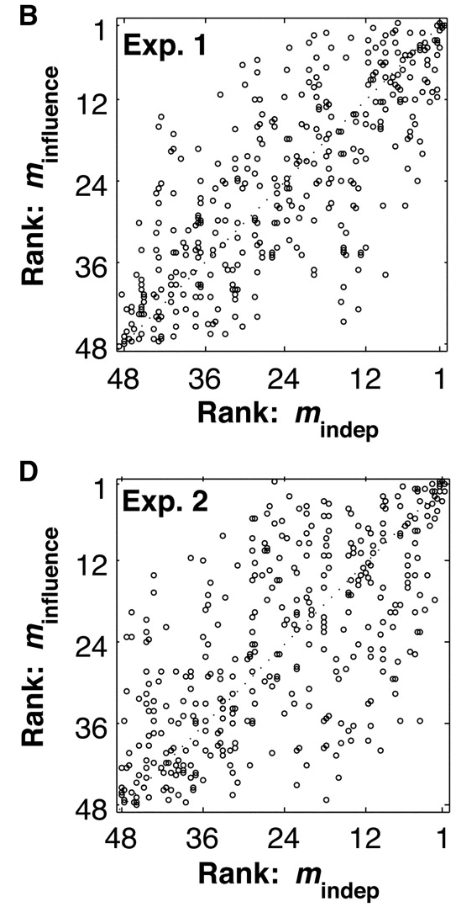
Ranking instability
Huge differences in popularity (inequality)
Few items become very popular
Popularity is weakly correlated with quality
The best and worst songs were correctly ranked.
Rank of mediocre songs is unpredictable
Multiple worlds experiment
Rerun the experiment from the same initial conditions. Different songs become popular

Slide 36
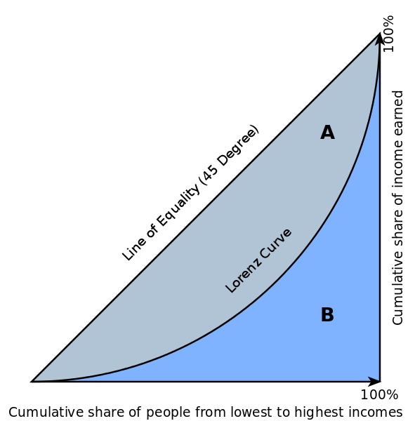
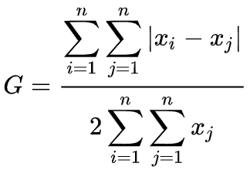
Measuring inequality
Gini coefficient measures the degree of inequality in a distribution of values.
Gini = A/(A + B)

Slide 37
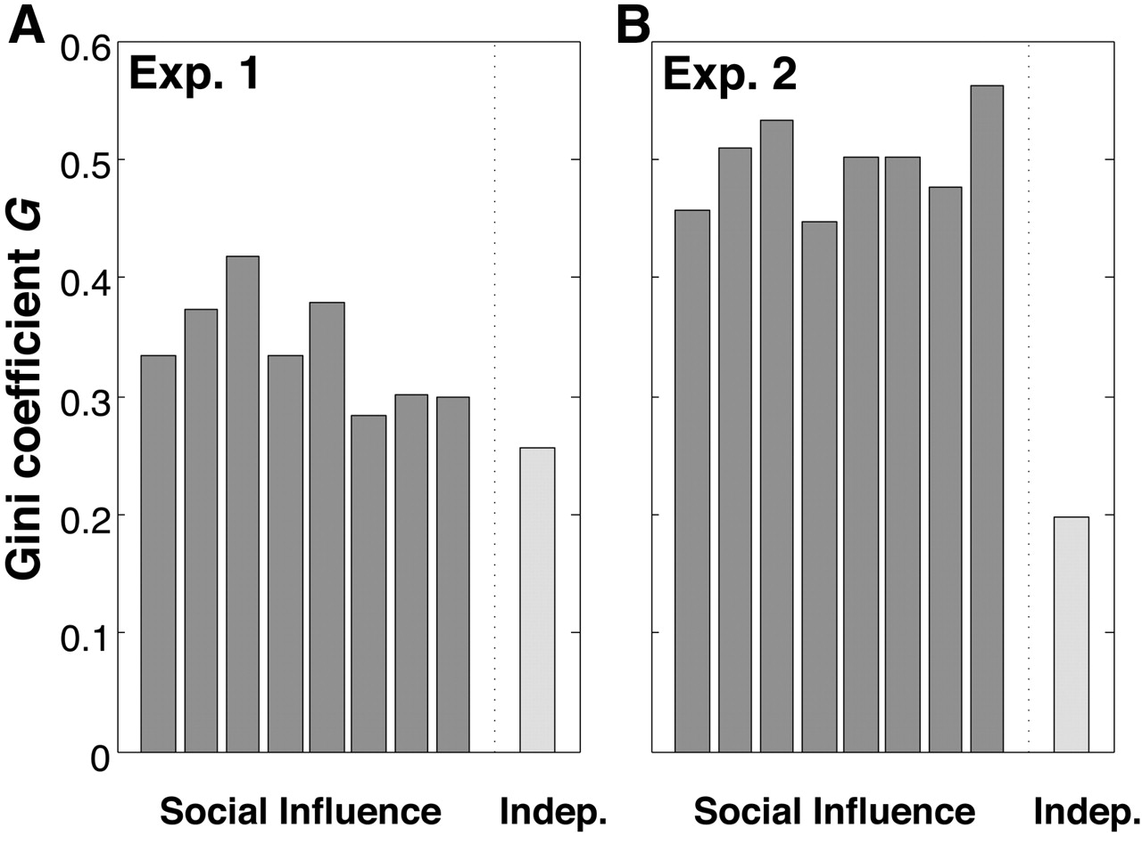
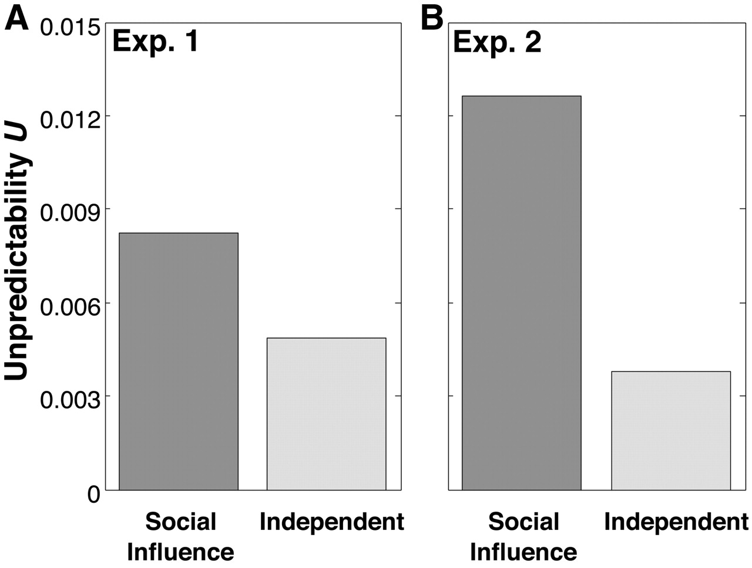

Inequality (A) and unpredictability (B) of song market share in the social influence vs independent conditions worlds
B
Matthew J. Salganik et al. Science 2006;311:854-856
Published by AAAS
Notes:
Inequality of success for social influence (dark bars) and independent (light bars) worlds for (A) experiment 1 and (B) experiment 2. The success of a song is defined by m_{i}, its market share of downloads \batchmode \documentclass[fleqn,10pt,legalpaper]{article} \usepackage{amssymb} \usepackage{amsfonts} \usepackage{amsmath} \pagestyle{empty} \begin{document} \((m_{i}=d_{i}{/}{{\sum}_{k=1}^{S}}d_{k}\) \end{document}, where d_{i} is song i's download count and S is the number of songs). Success inequality is defined by the Gini coefficient \batchmode \documentclass[fleqn,10pt,legalpaper]{article} \usepackage{amssymb} \usepackage{amsfonts} \usepackage{amsmath} \pagestyle{empty} \begin{document} \(G={{\sum}_{i=1}^{S}}{{\sum}_{j=1}^{S}}|m_{i}-m_{j}|{/}2S{{\sum}_{k=1}^{S}}m_{k}\) \end{document}, which represents the average difference in market share for two songs normalized to fall between 0 (complete equality) and 1 (maximum inequality). Differences between independent and social influence conditions are significant (P < 0.01) (18).

Slide 38
Conclusions of the MusicLab study
Social influence distorts collective outcomes in markets
Popularity is only weakly correlated with quality
Social influence is responsible for the inequality and unpredictability of popularity
But, MusicLab study did not attempt to control for the salience of the social signal – attention paid to songs solely due to their position in the list

Slide 39
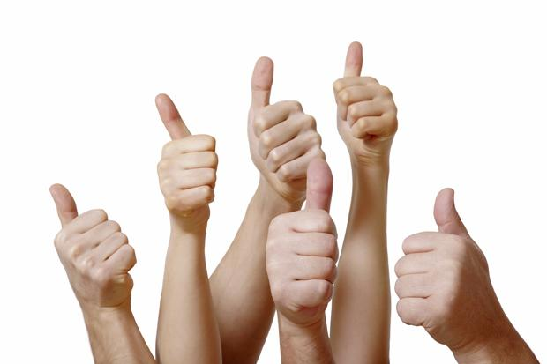
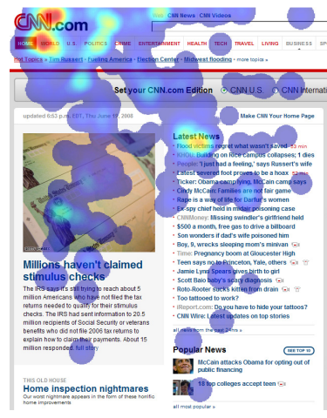
Social influence or position bias?
Social influence: People pay more attention to the popular choices
Position bias: People pay more attention to items at the top of the screen or a list of items [Payne 1951]
[Buscher et al, CHI’09]

Slide 40
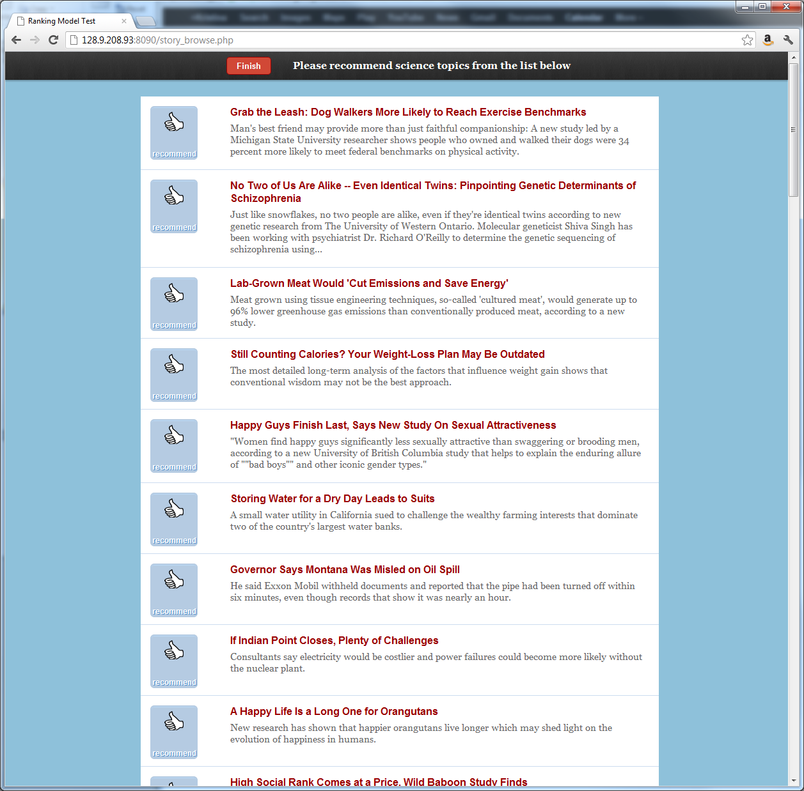
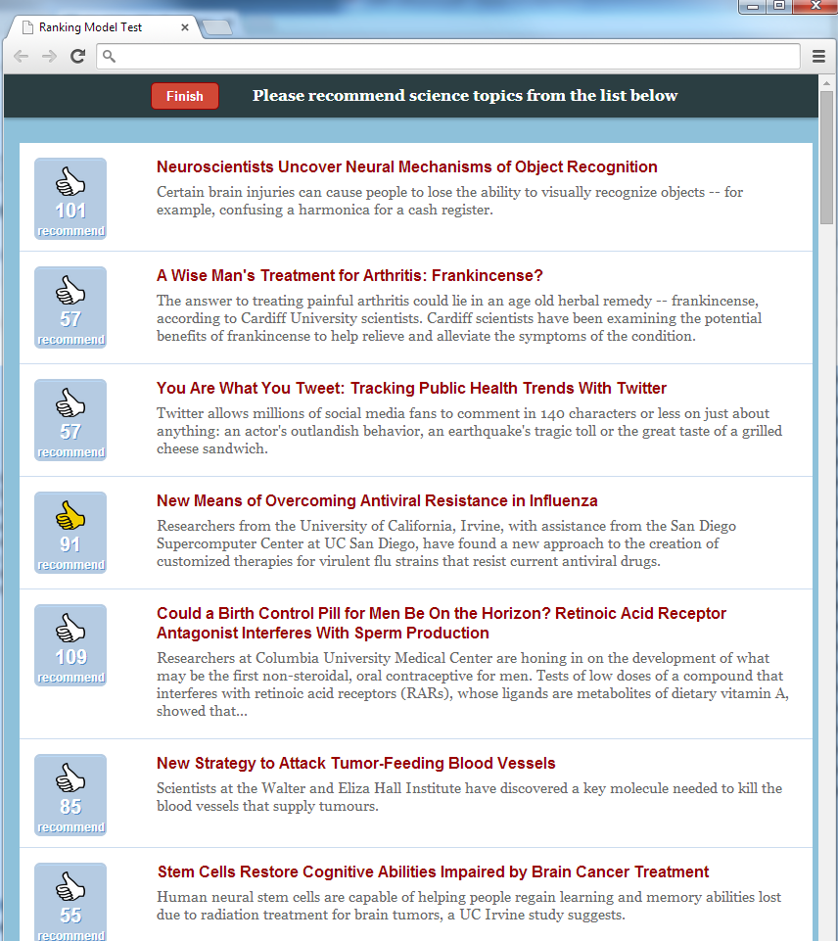
Measuring position bias
Quantify the effects of position bias on individual’s choices and collective outcomes (story popularity) via Amazon Mechanical Turk experiments
No social influence condition
Social influence condition (#likes shown)
[Lerman & Hogg (2014) “Leveraging position bias to improve peer recommendation” in PLoSOne]
Notes:
Can we control user attention – through story ordering – so as to improve outcomes of peer recommendation?

Slide 41
4 algorithmic ranking schemes
Participants asked to recommend (like) stories from a list 100 science stories
click on URL to read the story
vote for (like) the story
Vary order 🡪 measure outcomes (popularity)
 | Story 89
 | Story 11
 | Story 35
 | Story 27
 | Story 8
 | Story 1
 | Story 2
 | Story 3
 | Story 4
 | Story 5
 | Story 7
 | Story 27
 | Story 56
 | Story 90
 | Story 8
 | Story 8
 | Story 56
 | Story 48
 | Story 73
 | Story 15
[random order]
control
[fixed order]
[by popularity]
# likes
[by recency]
of likes
[Lerman & Hogg (2014) “Leveraging position bias to improve peer recommendation” in PLoSOne]

Slide 42
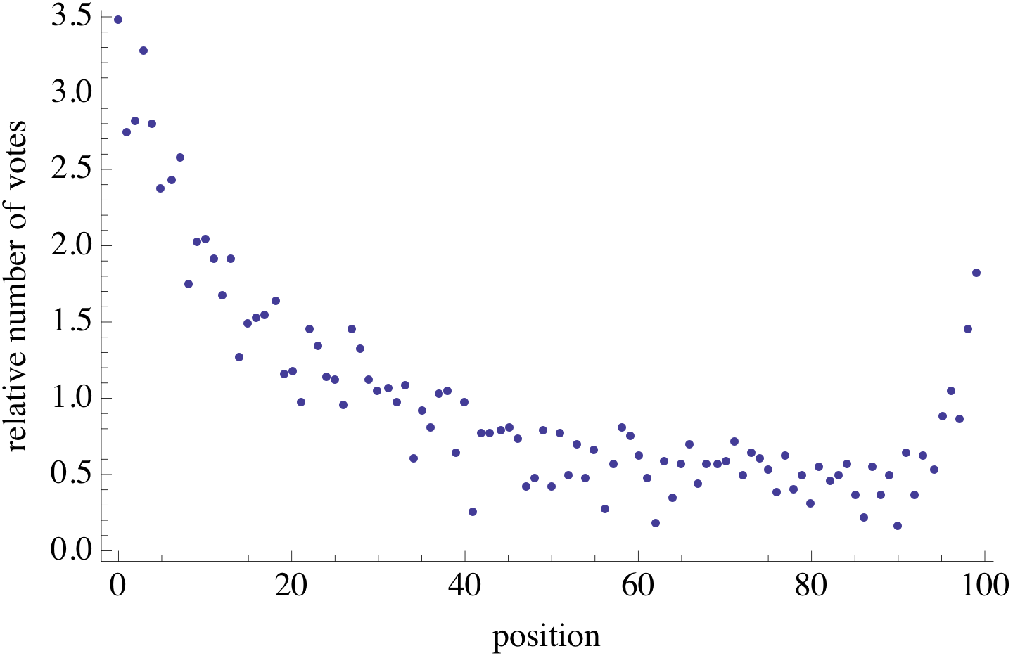
Position bias
All things being equal, items in top list positions receive 4x-5x more attention than those in lower positions
[Lerman & Hogg (2014) “Leveraging position bias to improve peer recommendation” in PLoSOne]

Slide 43
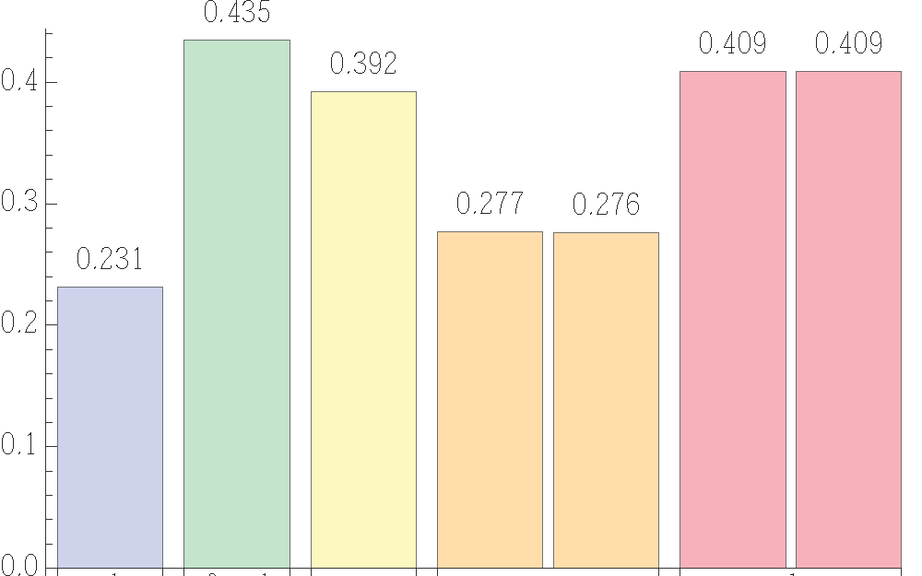
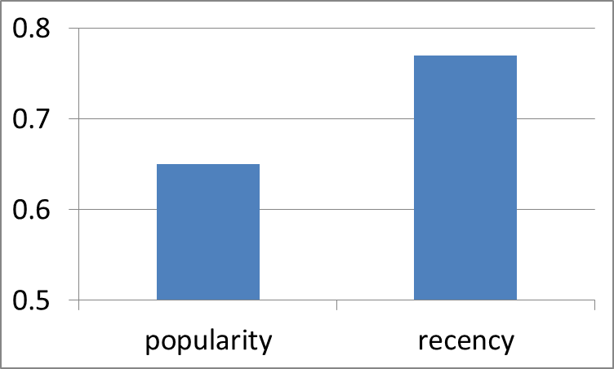
Same outcomes as MusicLab
Unpredictability of popularity: Correlation of outcomes across parallel worlds
Inequality of popularity: Gini coefficient of the number of likes received
random
fixed
recency
popularity
Position bias results in large inequality and unpredictability when ranking items by popularity
[Lerman & Hogg (2014) “Leveraging position bias to improve peer recommendation” in PLoSOne]
Notes:
Visibility, rather than social influence, explains large inequality and unpredictability of outcomes

Slide 44
Measuring social influence bias
How does “social proof” (the number of likes) affect collective outcomes (popularity)?
[Hogg & Lerman (2015) “Disentangling the effects of social signals” in Human Computation Journal]

Slide 45
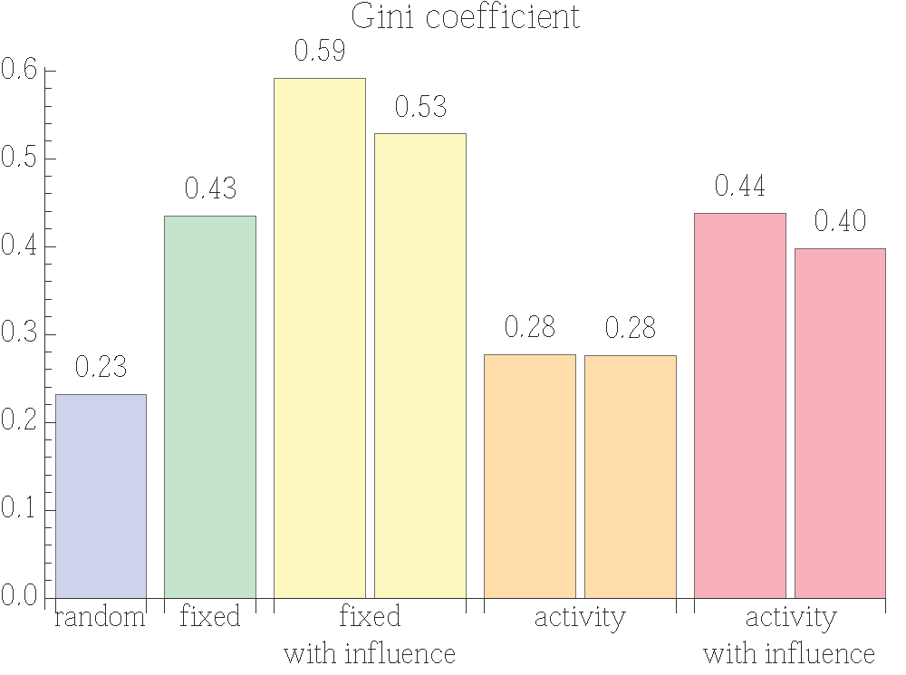
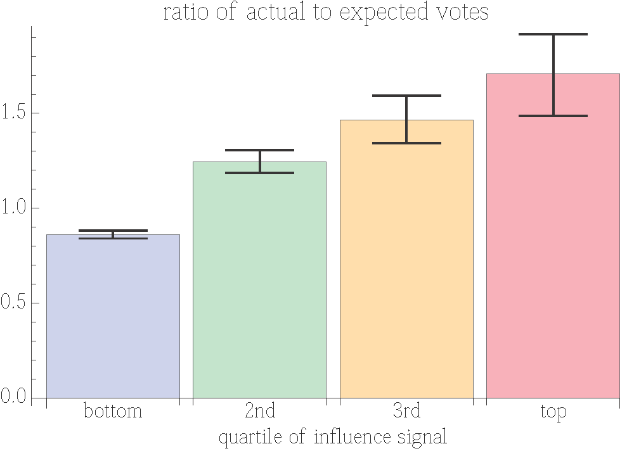
Social influence and collective outcomes
Items with higher “social proof” get more attention (after controlling for quality and position)
“Social proof” (influence) increases inequality
Gini coefficient
Ratio of actual to expected likes
quartile of the social signal
random
fixed
fixed
w/ social signals
recency
recency
w/ social signals
[Hogg & Lerman (2015) “Disentangling the effects of social signals” in Human Computation Journal]

Slide 46
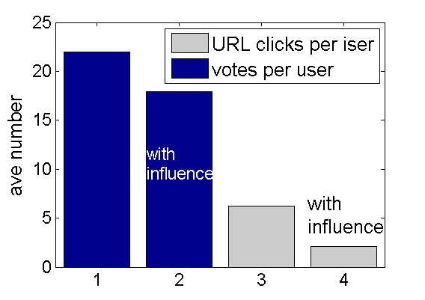
Social influence improves collective efficiency
Social influence reduces effort: people read and like fewer stories with social signals (20% less time)
likes per user
URL clicks per user
[Hogg & Lerman (2015) “Disentangling the effects of social signals” in Human Computation Journal]
Notes:
What use is social influence?
Social influence does bias individual preferences and increase inequality, but by directing attention to high “quality” stories, it helps reduce evaluation effort, increasing efficiency of peer recommendation

